Slide 1
ITEC 2560 Web Client & Server Programming
Welcome!

Slide 2
Agenda
Course introduction
Syllabus
HTML and CSS
Lab 1

Slide 3
Web Development
Huge industry; practically every organization has a need to work with the web to a greater or lesser degree
Web applications are everywhere
Just about everyone has a browser and knows how to use it; so potentially anyone can use your application
Standard user environment: You don't have to think about client installs; no downloads; no need to deal with different hardware/platforms/OS, just need to make your application run on a server, and be viewable in a browser*
A lot of Java, C# code being developed is for web applications (eBay, Amazon, Twitter…)
Mobile apps typically interact with a web app back end
*This is not trivial, but much easier than building a Windows, Mac, Android, iOS, Linux, Unix…. version of your application

Slide 4
Web Development
Huge variety of diverse applications that can be accomplished with web technologies
So this is a very useful class to take. Good choice!
Wide variety of technologies have evolved (and continue to evolve) to meet different needs
There's a lot of different web technologies; for different purposes; different technology stacks

Slide 5
This Class
So we can't possibly cover everything
Technologies that are used in (almost) all web applications
HTML, CSS, front end (client-side) JavaScript (and front end frameworks)
Fundamentals of the client/server model; overview of how HTTP works
Server application logic
Databases
But that leaves lots of choice – what server-side tools, frameworks, and languages do we use?
What front-end/client-side frameworks should we use?
What database technology will we need?
How do we deploy our websites – what server hardware and software will host the site?

Slide 6
Front End (client-side) code
Front end = client side
Client = browser
So front end = things that are run by a browser
HTML - describes the content of a page
CSS - applies styles, colors, layout to the page
JavaScript - interactivity on the page
Vue.js (pronounced 'view or view-j-s') - a JavaScript front end framework

Slide 7
Server Code: JavaScript, Node, Express
We'll use JavaScript server code/frameworks: Node.JS, Express.JS
Opportunity to get more experience with JavaScript
Node.JS etc. are growing in popularity and suit small-to-medium sites very well
Trend towards microservices (create several small Nodejs apps, one per specific task) vs. monolithic architecture (e.g. one giant Java/C# app)
Plus it's all free
Walmart, PayPal, Target, NASA all use Node
Other server language options include Ruby, Java, Python, C#, PHP… many languages can be used to write web apps

Slide 8
Databases
You have taken (or will be taking) a relational database class (SQLServer, MySQL, Access…) and you may know SQLite
Almost all web sites require a database of some kind
We'll use PostgreSQL (usually pronounced 'post-gres') for our databases. We'll use a cloud PostgreSQL service, so you don't need to install it locally
It's very similar to other relational databases, and we don't plan to use many advanced features

Slide 9
Node/Express
Very useful for small-to-medium websites; getting something up and running quickly; but also can deal with high demand sites; robust; good at handling many users simultaneously
The Minneapolis Institute of Arts (MIA) website is a Node website
Strategies, tools and concepts translate to other technology stacks; so what you learn here will be relevant to (for example) C# ASP or Java Server Pages

Slide 10
Vue.js
You may have heard of Angular and React, two front end JS frameworks that are really popular right now
Front end frameworks: used to move application logic to the user's browser, makes websites faster and more responsive once they've loaded, and saves the server a lot of work
But they are large, complex, and keep changing
We'll need an entire semeseter to study React or Angular
So, we'll use Vue.js, also popular but less complex and more friendly to learn
Once you know Vue.js, it's much easier to learn React or Angular

Slide 11
How we'll structure this class
This class will cover a lot of different technologies; plus software developer tools, and other issues such as user interface design, security…
Web development requires breadth of knowledge
Versus a class like Java or C#, that cover one language in depth

Slide 12
Note on Web Design
This is not a web design class. Clara is most definitely not a web designer!
We'll focus on logical user interface layouts; usability; having the correct components for a page
And use CSS and CSS frameworks to apply styles, and make things look less 1990s
But we won't get into much depth... if you are interested in design, you are encouraged to explore more
It's a whole different industry and set of skills – check out the Graphics and Web Design department's classes if you are interested in learning more
In this class, we are going to focus on making things work; server-side logic and database; providing the correct content and functionality in the client

Slide 13
Pre-requisites
Programming Logic; use of a scripting language e.g. Python
I'll assume you can write basic programs in Python; you understand the concepts of variables; data types; control flow; methods/functions; strings; library functions; lists and dictionaries
You can install software
You have basic command line/terminal skills
You can do research to solve problems that you'll run into
You can look things up; read documentation
Otherwise, we'll start at the beginning; assuming you have no prior knowledge of any web technologies

Slide 14
Syllabus
Quick review
Important parts:
Labs
Online and on campus components
Schedule
Plagiarism policy

Slide 15
Software (for now)
Chrome web browser
Each browser handles HTML, JS and CSS slightly differently. Browser compatibility testing is a important part of production code, but we'll disregard for this class
Programming-centric text editor
VSCode, Notepad++, Atom, Sublime Text, Brackets, WebStorm…
Install a few, try them out, use the one you like best
You don't need many features - but nice things to have include syntax highlighting, auto-indentation, auto-complete, tabbed editor windows, convenient keyboard shortcut for saving code and other common tasks
You'll need more software around midterm
Node.js, NPM
Heroku toolkit
Possibly others. All software is free and works on PC, Linux, Mac. Links and instructions will be provided as needed

Slide 16
Code time!
Today: HTML and CSS

Slide 17
Essentials: HTML and CSS
Hypertext Markup Language
HTML: what every web page is made of
HTML describes the content of a page: data about the page, and the elements that make up a web page – text, images, tables, video, links, lists, and other resources on a page, and data about these elements
HTML describes page content - what elements are there, what data do they contain, what do they represent?

Slide 18
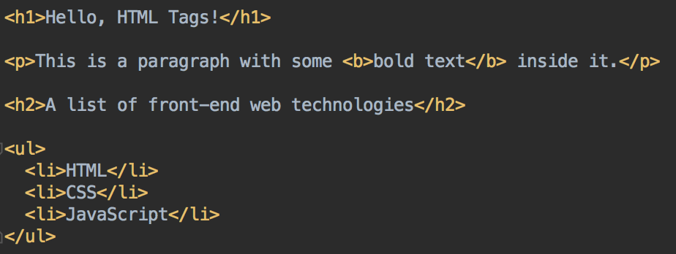
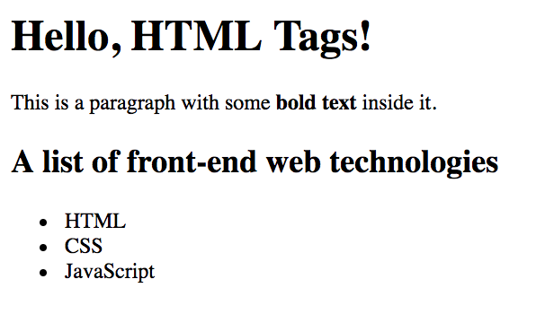
The HTML above will render like this in a browser ->

Slide 19
Essentials: HTML and CSS
HTML is for creating types of elements: a paragraph, an image, a list
HTML is used to define what text is in an element
HTML elements can be nested

Slide 20
Essentials: HTML and CSS
HTML elements can have attributes
Specifying the image file for a image element, or the alt-text, or tooltip text
Specifying the URL for a link
adding a unique id to identify one particular element on a page;
or giving many elements the same class, to identify elements of the same
Many other attributes

Slide 21

HTML Elements
Tag name: h1
Contents – in this case, the text Hello, HTML Tags!
Opening tag
Closing tag – note the /
HTML Element

Slide 22
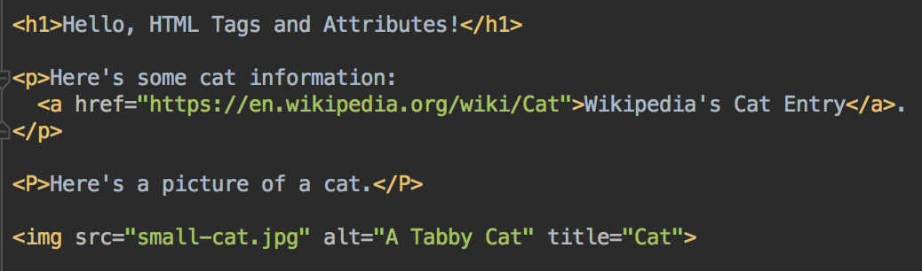
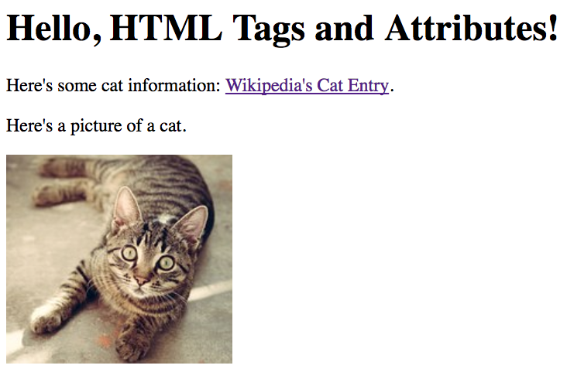
HTML Element Attributes
The link is created with an a tag with one attribute:
href attribute for the URL. Required.
The image is created with an img tag. It has 3 attributes:
src attribute for the image file. Required.
alt attribute for alt–text (for screen-readers or text that is displayed if the image can't. Optional but recommended.
title attribute, displayed as a tool-tip when the image is hovered over. Optional.

Slide 23
HTML Elements with Attributes
Tag name: a
Contents – in this case, text
Attribute inside tag, as name="value"
Opening tag
Closing tag
Element
An element can have many attributes. Separate name="value" pairs with spaces

Slide 24
HTML Attributes
Attributes are used to provide extra information about an element
href in a elements; and src in img elements, are attributes
Can specify the attributes' value using single or double quotes. Double quotes more common, but whichever you choose, be consistent
<p>I attend <a href="http://www.minneapolis.edu">MCTC</a></p>
<p>Here is a bear picture: </p>
<img src='https://placebear.com/300/200'>
Single quotes ok too but double quotes more common. Don't mix single and double quotes for an attribute value

Slide 25
Essentials: HTML and CSS
CSS: Cascading Style Sheets
Configures the appearance of your HTML elements - color, position, size, font, borders, animation…
Can specify a particular style for all elements of a particular type
So can use CSS to make all of the page header text bold and 20-point and green
Or make all of your images 100 x 100 and give them all a blue 1-pixel border
Or can select some components and apply a style
Select all elements with a certain class
Select the element with a certain ID
Select the last element of a type on the page
Select only elements by context e.g. only list items in ordered lists, but not in unordered lists

Slide 26
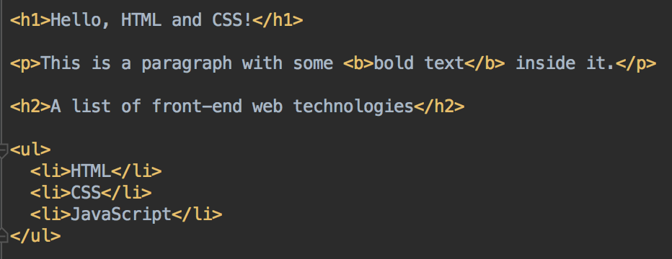
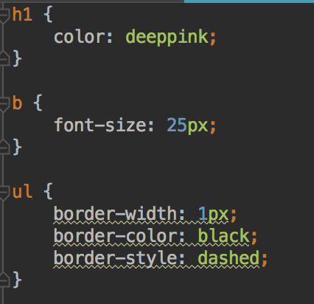
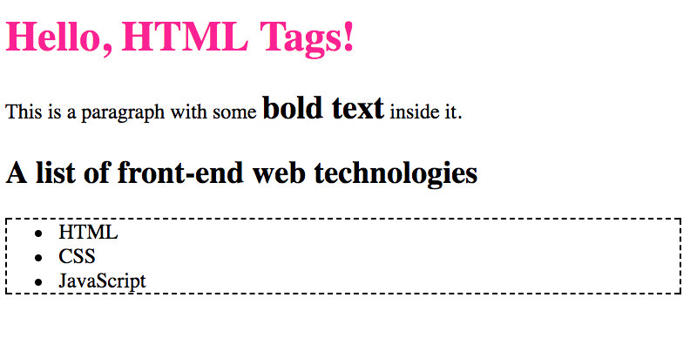
HTML and CSS

Slide 27
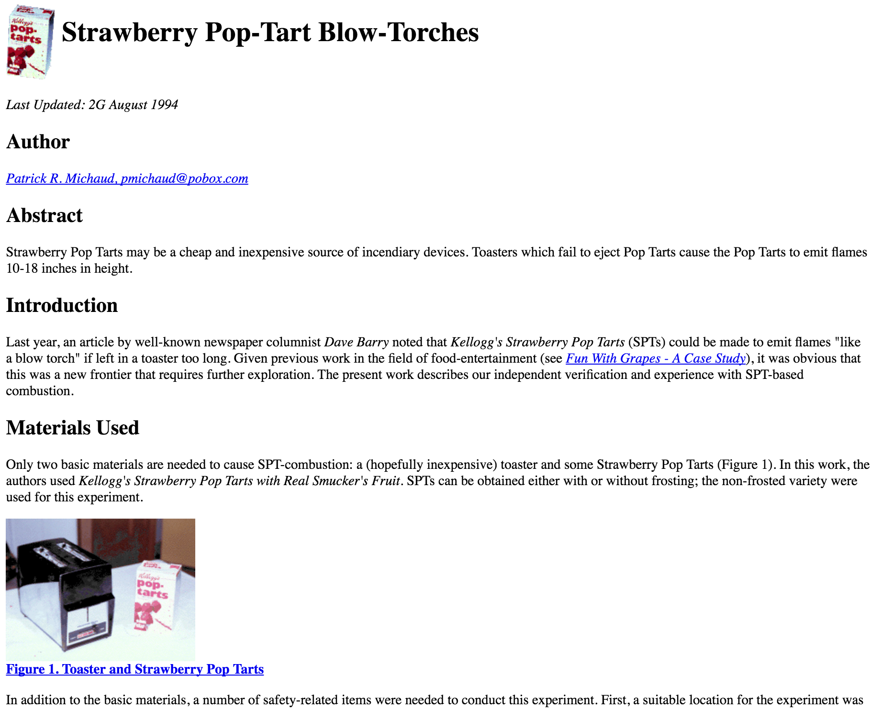
Essentials: HTML and CSS
In the olden days…
Websites specified elements and layout/styles in one document
Works, but harder to change one or the other consistently.
CSS existed but was kinda optional
Old site, no CSS

Slide 28
Essentials: HTML and CSS
Today: HTML and CSS are independent technologies that work together to create a page
HTML to describe the page content
CSS to describe what it looks like.
Keeping HTML and CSS separate enables re-use; make change easier

Slide 29
Essentials: HTML and CSS
Typical roles:
a web developer would make sure the correct elements are on the page, ensure correct functionality; mainly using HTML
a web designer would write CSS to create the correct layout and appearance
Content creators would generate the actual content
As web developers, we'll need to provide HTML that CSS can be applied to - with appropriate elements; and giving elements useful class, ID and other attributes
Complex CSS is more for web designers; but developers find it useful and use it too

Slide 30
First HTML
Open a text editor
In your text editor, enter the text on the following slide
Save your file as hello.html
Open this file in your web browser
Either double-click on the file from Explorer/Finder,
Right-click on file, Open in Chrome
or from Chrome; File > Open File… and select hello.html from the directory you've saved it in

Slide 31
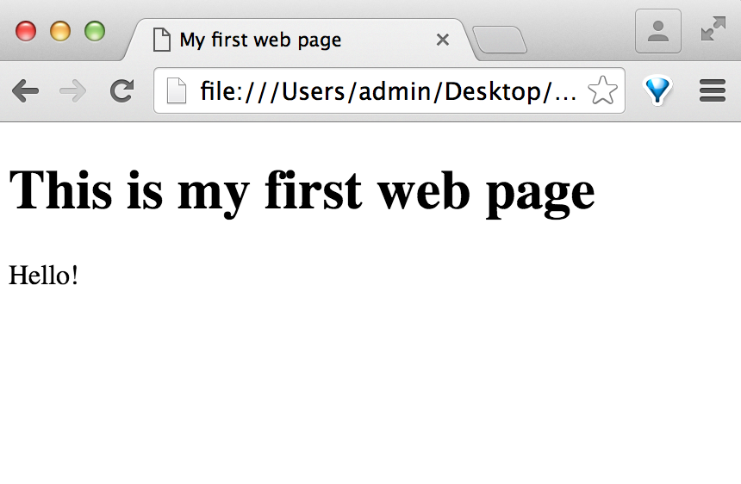
<!DOCTYPE html>
<html>
<head>
<title>My first web page</title>
</head>
<body>
<h1>This is my first web page</h1>
<p>
Hello!
</p>
</body>
</html>

Slide 32
<!DOCTYPE html>
<html>
<head>
<title>My first web page</title>
</head>
<body>
<h1>This is my first web page</h1>
<p>
Hello!
</p>
</body>
</html>
Specifies this page is HTML5
<head> …. </head>
Information about the page, scripts; metadata; CSS info, information for search engines and web crawlers… Other than the page title; this is not seen by user.
<body>…. </body>
The visible page content

Slide 33
<!DOCTYPE html>
<html>
<head>
<!--metadata e.g. links to stylesheets here -->
</head>
<body>
<!-- document content here -->
<body>
</html>
Well formed HTML follows this format.
Remember this slide: start your pages with this template
(Webstorm provides it for you)

Slide 34


HTML Elements
Start with an opening tag and end with a closing tag*
<b> and </b> in this example
<b>here's some bold text</b>
Can nest tags inside other tags
<p>You <b>must</b> watch the new <i>Dr Who</i> episode!</p>
Make sure tags are completely contained in their parent tag; and each open tag has a matching closing tag
A closing tag always belongs to the closest opening tag of the same type
*Some exceptions, like comments, br, img and link elements

Slide 35
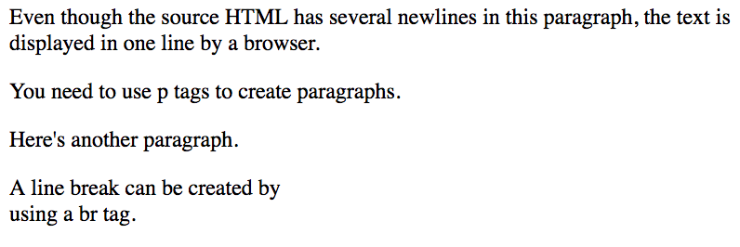
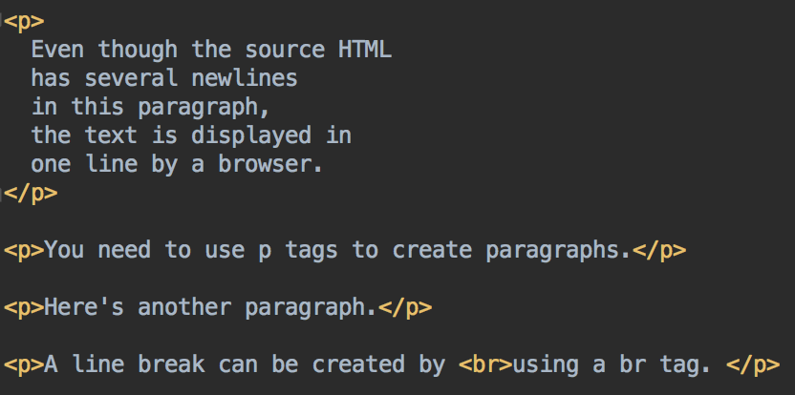
Common HTML Elements
HTML Tags are not case sensitive
Indentation doesn't matter; most whitespace is ignored - so if you want a new line on your page, you need to use <p> or <br> tags
Malformed HTML will either be ignored, or your browser will attempt to correct it. It won't crash, but it might not display as you intended

Slide 36
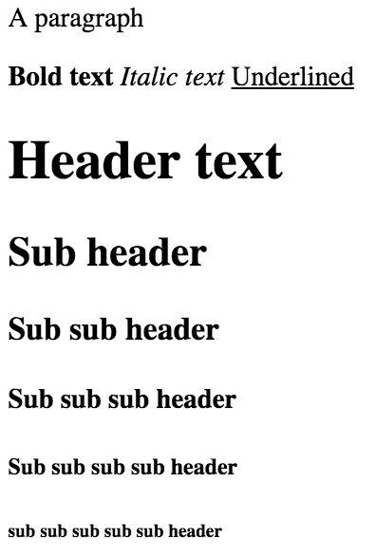
Text Formatting Tags
<p>A paragraph</p>
<b>Bold text</b>
<i>Italic text</i>
<u>Underlined</u>
<h1>Header text</h1>
<h2>Sub header</h2>
<h3>Sub sub header</h3>
<h4>Sub sub sub header</h4>
<h5>Sub sub sub sub header</h5>
<h6>sub sub sub sub sub header</h6>

Slide 37
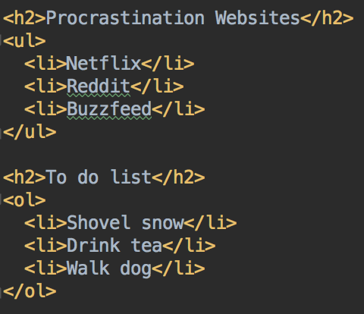
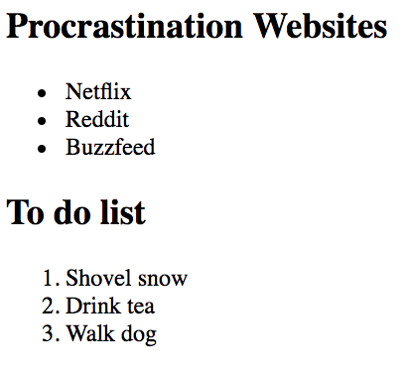
Lists
Two types of lists – ordered <ol>, and unordered <ul>
Nest <li> elements inside <ol> or <ul> elements to create each list item element

Slide 38

HTML: Links
Use the <a> tag for links
Specify the link target with the href attribute
Can specify the URL as a relative link, for another page on your own site
Or a full URL (including http or https) to an external site
Text inside the <a>… </a> tags will be the link text
<a href="http://www.minneapolis.edu">MCTC</a>
<a href="http://www.buzzfeed.com">Buzzfeed</a>
<a href="home.html">To Home Page</a>
Relative to current page

Slide 39
HTML Comments
<!-- This is a comment -->
Comments must be all on one line

Slide 40
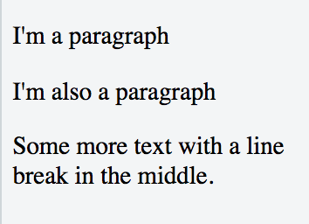
Paragraphs and line breaks
Paragraphs; enclose text in <p>…</p> tags
Breaks: single <br> tag
<p>
I'm a paragraph
</p>
<p>
I'm also a paragraph
</p>
Some more text with a line <br> break in the middle.

Slide 41
Your Turn
Please create a new web page: favorites.html
Start with the template HTML (go back to slide 28 or so)
Add a header H1 element, with the text "Some of my favorite things"
Add a H2 tag with the text "Favorite Movie"
Add a paragraph of text, a short description of one of your favorite movies
Include a a link to a website about that movie.
The name of the movie should be in italic text.
Add a H2 tag with the text "Favorite Band"
Add a paragraph about your favorite band/artist,
Include a link to the band/artist website.
The name of the band should be in bold text.
Add a H2 tag with the text "Favorite Foods"
Add an unordered (bullet point) list of your 3 favorite foods

Slide 42
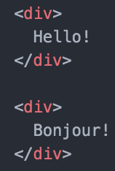

Organization: div and span
<div> divider, for dividing text into logical sections. div is a block tag. One div will be placed after another.
<span> are inline tags - a span element will directly follow after the preceding element, and be directly followed by the next element.
Otherwise, not visible in your page unless you use them to apply certain styles
span and div are not very useful without attributes

Slide 43
Your Turn
Modify your favorites.html web page and add div tags to organize it into sections; and span tags for some of the information
Surround the movie information section (the H2 and paragraph) with a div
Surround the movie title with a span
Surround the favorite band/artist section (H2 and paragraph) with a div
Surround the artist name with a span
Surround the favorite food section (H2 and unordered list) with a div

Slide 44

More HTML: Images
<img src='http://placekitten.com/g/450/350'>
<img src='http://placekitten.com/g/450/350' height=100 width=100>
Use the <img> tag for images. No close tag needed. Specify the location of the image as a src attribute
src can be absolute or relative
Can specify size with height and/or width attributes. Image will be scaled proportionately if you only specify either height or width attribute

Slide 45
Where to get images?
Use images that you own - pictures you took/created
Use public domain images or licensed for reuse
Wikimedia commons, https://commons.wikimedia.org/wiki/Main_Page
Pixabay.com, Libreshot, Unsplash.com, various others
Use a placeholder image generator
http://www.hanselman.com/blog/TheInternetsBestPlaceholderImageSitesForWebDevelopment.aspx
Be aware of reuse restrictions on images owned by others; ensure that you only use images that you have permission to

Slide 46
Your Turn
Add an image: download a public-domain image from (e.g.)
Unsplash.com
https://commons.wikimedia.org/wiki/Main_Page
or other public domain site
Save in same directory as your html file
Add to your page, use a relative link
<img src="myimagefilename.jpg">

Slide 47
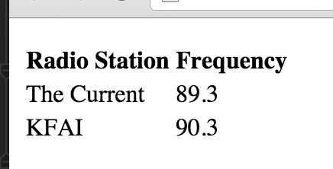
More HTML: Tables
<table>, <tr>, <th>, <td> for creating tables
<tr> for a table row
<th> for header rows, <td> for table data elements
Notice how elements are nested
The bold text for headers is a default style applied by your browser. Can override with CSS
<table> <tr><th>Radio Station</th><th>Frequency</th></tr> <tr><td>The Current</td><td>89.3</td></tr> <tr><td>KFAI</td><td>90.3</td></tr> </table>

Slide 48
HTML and CSS

Slide 49
CSS: Cascading Style Sheets
As you build you HTML, think about what elements will need to be styled
Decide which elements you want to style
For example, all of the elements of one type?
All of the elements with a particular class?
Create a CSS selector to select only those elements
In the selector, declare the styles for that element
Repeat for each style needed
Link the stylesheet to your HTML
The browser will apply styles to all the elements that match the selection

Slide 50
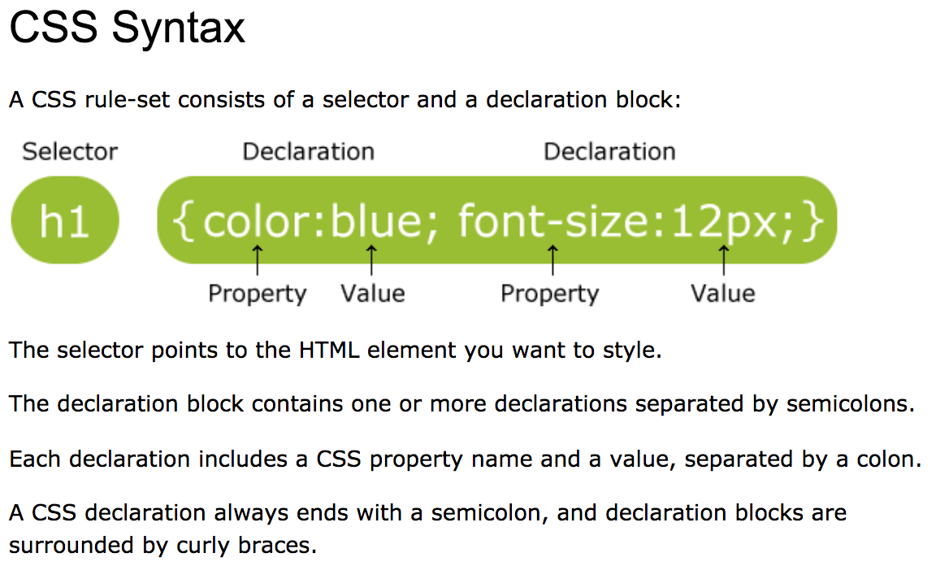
CSS Syntax
W3Schools.com https://www.w3schools.com/css/css_syntax.asp

Slide 51
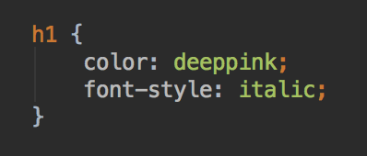
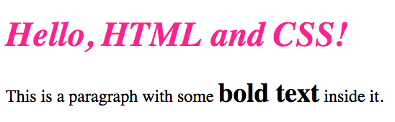
CSS Syntax
selector {
property: value;
property2: value;
}
Add as many style declarations as you need
CSS is picky about syntax. if your styles don't appear, look for syntax errors

Slide 52
Style
Currently, your page is the default font, and black text on white background
Let's use CSS to add some styles
Create a file called style.css and save in the same directory as favorites.html

Slide 53
style.css p, h1, body are CSS selectors
p {
color: blue;
}
h1 {
color: white;
}
body {
background-color: orange;
}
/* Change these colors to colors of your choice. */
List of valid HTML color names
http://www.w3schools.com/html/html_colornames.asp

Slide 54
style.css
This is an external style sheet
Need to tell your HTML where to find it
Then, when the page is loaded, your browser will locate the stylesheet, and apply the styles defined to the relevant HTML elements
Modify favorites.html as in the following slide
Add a link tag with the location of styles.css

Slide 55
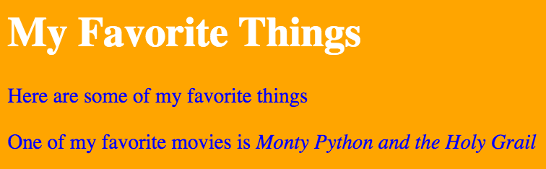
favorites.html
<!DOCTYPE html>
<html>
<head>
<title>My first web page</title>
<link rel="stylesheet" type="text/css" href="style.css">
</head>
<body>
<h1>My Favorite Things</h1>
<!– rest of your content is here -->
</body>
</html>

Slide 56

Edit style.css to add more CSS selectors. Use colors and border style/width of your choice. (dotted, dashed, solid, double…) Can you add a background color to your unordered list? Can you add a solid border around your H1 elements? Save and refresh the page to see the new styles.
p {
color: blue;
font-size: 20px;
}
/* Center H1 elements */
h1 {
color: white;
text-align: center;
}
body {
background-color: orange;
}
/*Remove underline from links,
set background color*/
a {
background-color: lightgreen;
text-decoration: none;
}
/*Add a border for image elements */
img {
border: red 5px dotted;
}

Slide 57
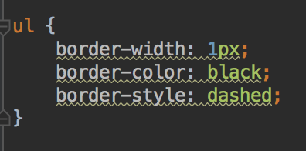
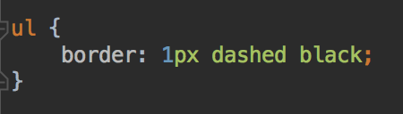
CSS Declarations
Some declarations can be collapsed
Example: border properties
Is the same as

Slide 58
CSS Syntax
Specify properties as property:value;
Each property should end with a semi-colon
Not case sensitive
/* Add comments like this */
Lots of CSS properties, see book or W3Schools guide/CSS reference http://www.w3schools.com/css/default.asp
A visual CSS reference: http://cssreference.io/

Slide 59
CSS Selectors
So far, you've used selectors to apply a style to every element of a particular type, for example, make all <p> text blue
Sometimes that's exactly what you want
But often, you'll want to differentiate between some of the same tags, maybe by context or position
perhaps depending on context, e.g. all bold text in an ordered list
Or the every other item of a type on a page
Or the first element of a type
Can add two types of HTML attributes to elements to enable CSS to select these elements: id and class
id is for identifying one unique element on a page
class is for giving elements a particular type

Slide 60
HTML class and id attributes
Can add to any HTML element
You define the attribute values
class to specify a type of element
Many elements can have the same class
id to uniquely identify one element
Only one element on a page can have a specific id
<ul id="todo_list">
<li class="important">Pay electric bill</li>
<li>Walk dog</li>
<li class="important">Grade papers</li>
<li>Shovel snow</li>
</ul>

Slide 61
Class and id HTML Attributes
Very useful
Used for selecting particular elements to apply styles to (next)
And for selecting particular element(s) to work with in JavaScript (in a few weeks)
Also useful for automatic tests on pages

Slide 62
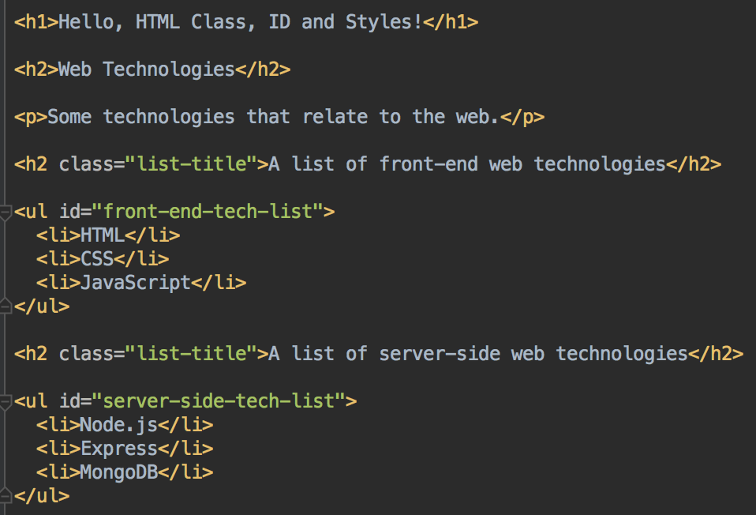
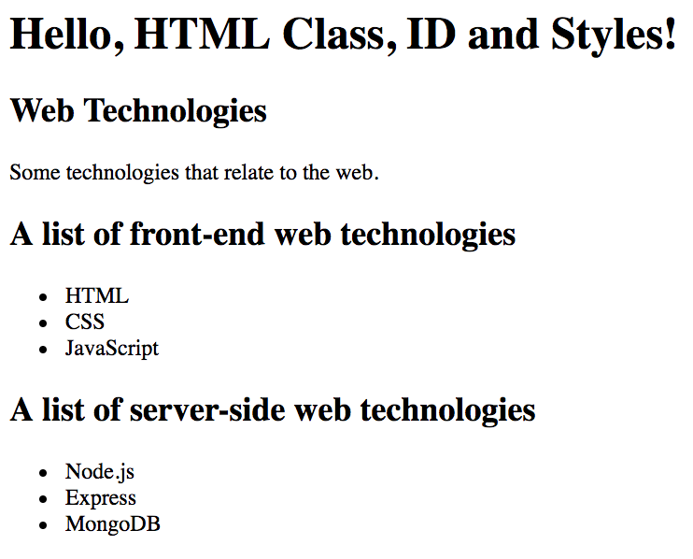
Adding class and id attributes to HTML
By themselves, class and id attributes don't make a difference to how the page renders

Slide 63
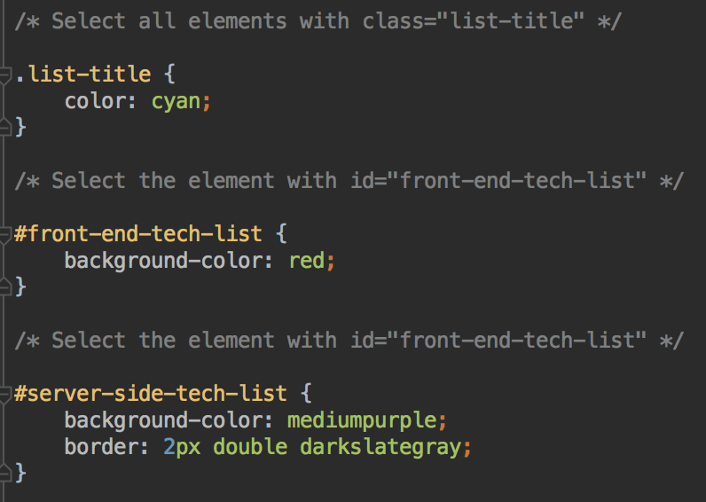
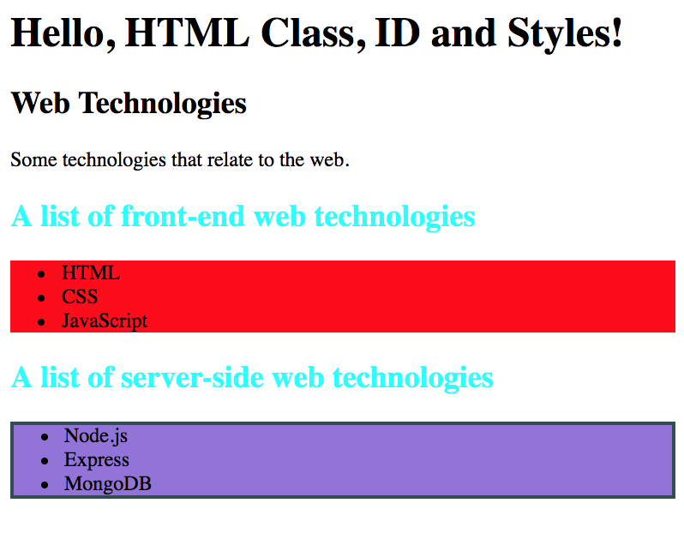
Using class and id to apply styles

Slide 64
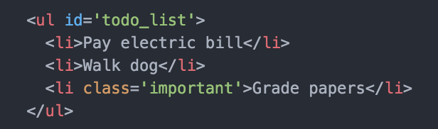
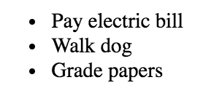
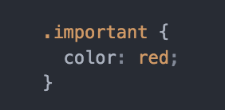
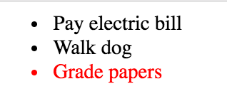
Selecting by class, HTML and CSS
HTML
Add CSS

Slide 65
id attributes in HTML
An element can have both class and id attributes (or one, or the other, or neither)
Add an id attribute with value: "favorite_band" to your favorite band span element , for example,
<p>A band I like is
<span id="favorite_band">REM</span>.</p>

Slide 66
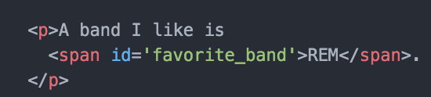

Selecting by id in CSS
Use # notation to select the element with this id
Add to style.css
Make your band name background yellow, or another the color of your choice
Or apply other styles of your choice
#favorite_band {
background-color: yellow;
}

Slide 67
class attributes
Use to identify more than one element that will have the same style applied
Elements don't have to be the same type
Add the attribute class="favorite_section" to all of your div elements
<div class="favorite_section">
<p>A band I like is
<span id="favorite_band">REM</span>.
Their website is <a href="http://www.remhq.com/">here</a>.
</p>
</div>
<div class="favorite_section">
<p>Some food I like is....</p>
</div>

Slide 68
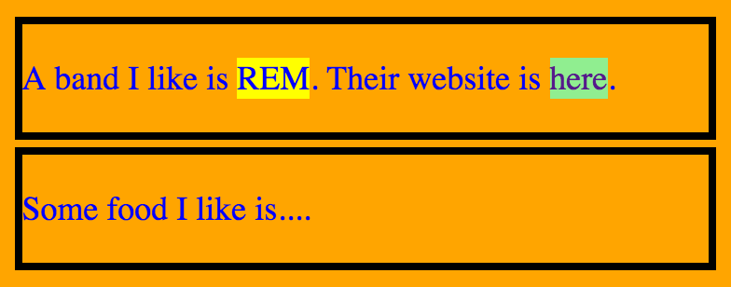
Select class in CSS
Use the . notation to select all elements with a particular class
In style.css, add a border and margin to each of your favorite_section elements
.favorite_section {
border: 5px black solid;
margin: 5px;
}

Slide 69
Padding, Borders and Margin
Padding separates the content from the border
Margin separates one element from another
CSS can customize the width of margin, padding, border
Can set the size on all the sides at once, or set each side individually

Slide 70
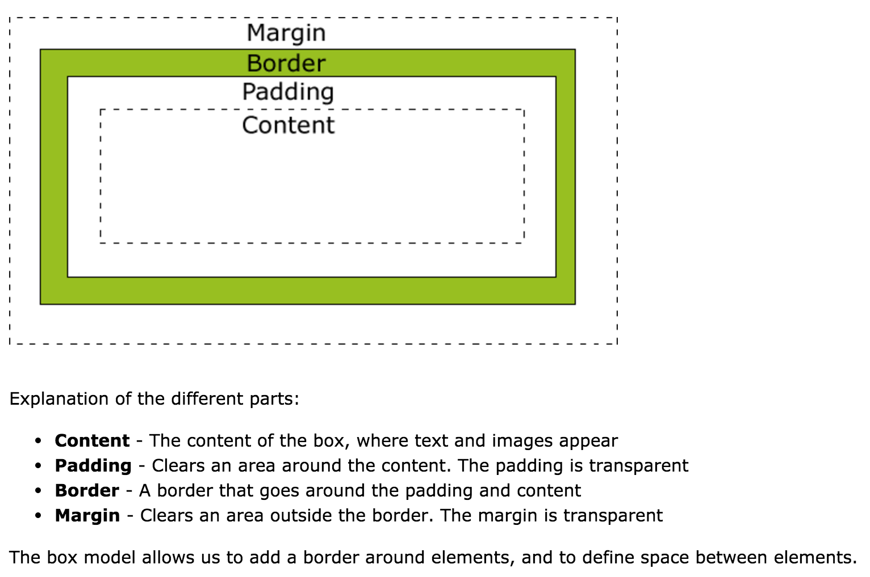
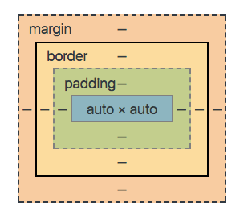
Padding, Borders and Margin
CSS treats every element on your page as being inside a rectangular box
Each box has a margin, border, padding, and content
Content is e.g. text, or image... depending on the element
Padding is between the content and border
Border surrounds the padding
Margin separates the box from it's surroundings
CSS can customize the size of the content
CSS can customize the size of each side of margin, border, padding
http://www.w3schools.com/css/css_boxmodel.asp

Slide 71

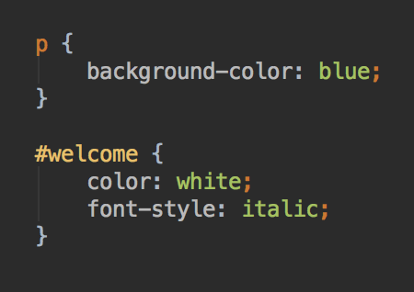

Cascading Styles
Since there's many ways to select elements, it's possible that an element can be selected by more than one selector
Elements will receive all the styles from all the selectors that match them
In this example, the p selector and the #welcome selector both select the p element, so all styles are applied

Slide 72

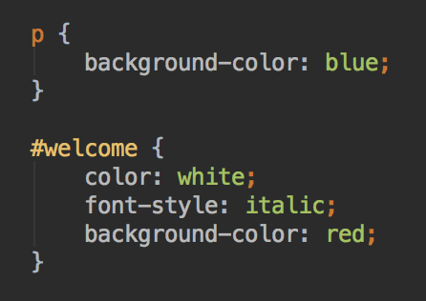

Cascading Styles
But what if there's a conflict?
For this element
And this stylesheet
the first selector selects all p elements
the second selects the element with id="welcome"
So both selectors will select the element
But, they both define a background-color style
What color will the background be?
The most specific selector will apply
So styles from selecting by id override selecting by class, and selecting by class overrides selecting by tag

Slide 73
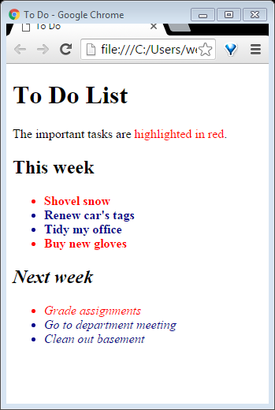
<!DOCTYPE html>
<html lang="en">
<head>
<meta charset="UTF-8">
<title>To Do</title>
<link rel="stylesheet" type="text/css" href="style.css">
</head>
<body>
<h1>To Do List</h1>
<P>The important tasks are <span class="important">highlighted in red</span>.</P>
<div id="thisweek">
<h2>This week</h2>
<ul>
<li class="important">Shovel snow</li>
<li>Renew car's tags</li>
<li>Tidy my office</li>
<li class="important">Buy new gloves</li>
</ul>
</div>
<div id="nextweek">
<h2>Next week</h2>
<ul>
<li class="important">Grade assignments</li>
<li>Go to department meeting</li>
<li>Clean out basement</li>
</ul>
</div>
</body>
</html>
/*Apply to all <li> tags*/
li {
color : darkblue;
}
/*Apply to all tags with class = "important". In this example,
two types of element have this class - some li elements and a span.
Notice how this overrides the li selector above for important li elements.
CSS will apply the most specific selector.*/
.important {
color : red
}
/* This applies to the element with id = "thisweek". Notice how
the style is also applied to the elements within this div element. */
#thisweek {
font-weight: bold;
}
/* Apply a style only to the
element with id='nextweek'*/
#nextweek {
font-style : italic;
}

Slide 74
First part of Lab 1
Continue working on your Favorite Things web page
Add some more information on your favorite bands, movie and foods - directions in D2L

Slide 75
Lab 1
Lab 1 worksheet and instructions for submitting the lab is in D2L
Due on the day before next class

Slide 76
Questions?
Please ask!
In your future job as a software developer or related occupation, you will be expected to seek feedback on your work
So you can improve and build your skills; and verify that what you are working on is what your employer expects
Practice now :)

